Slide 1
Lab 04
Introduction to Quartus II and DE0
Source: Purdue ECE270

Slide 2
INSTRUCTIONAL OBJECTIVES:
To learn how to use Quartus II to design logic circuit, and download the design into FPGA chip.
To learn how to connect simple input and output devices on DE0.
2

Slide 3
STEP (1): A VOTING MACHINE
A small company has 100 shares of stock divided among 3 people. The shares are divided as follows:
  Mr. A 15 shares
  Mr. B 50 shares
  Mr. C 35 shares
A measure that has been voted on passes if there is a more than half majority. Each person votes with all of their shares (1) or none of their shares (0).
Write out the truth table for all possible votes. Construct the logic equation for the votes and use Boolean algebra to simplify the equation.
Design a circuit using logic gates which lights an LED whenever a measure passes.

Slide 4
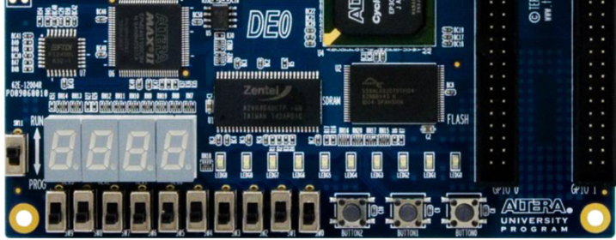
STEP (1): A VOTING MACHINE
Use Quartus II’s graphical editor to create the design and perform a functional simulation
Assign pins and download the design to your Altera DE0 board, as shown below.
A
B
C
Pass

Slide 5
STEP (2):
Utilize some combination or subset of: 74HC00, 74HC02, 74HC04, 74HC08, and 74HC10 (numerous solutions are possible), to wire up your “discrete” voting machine circuit on breadboard.
Use a DIP switch for the three inputs and a RED LEDs to indicate the pass status.
Keep track of the amount of time it takes you to wire and debug your circuit .

Slide 6
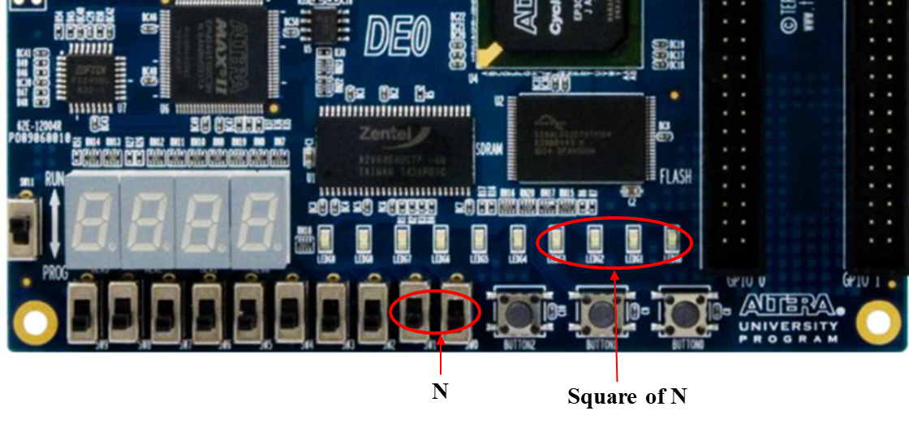
STEP (3): A SQUARE CIRCUIT
Design a digital circuit that its input is a 2-bit binary number N and its output is the square of N.
Use Quartus II’s graphical editor to create the design and perform a functional simulation
Assign pins and download the design to your Altera DE0 board, as shown below.

Slide 7
STEP (4): THOUGHT QUESTIONS
Compare the amount of time it took you to complete (i.e., wire, test, and debug) Experiment Step (2) versus Experiment Step (1), expressed as a ratio (e.g., 2:1 or 1:3).
If there were 6 input variables instead of 3, in what way (if any) would you expect this ratio to change?

